Slide 1
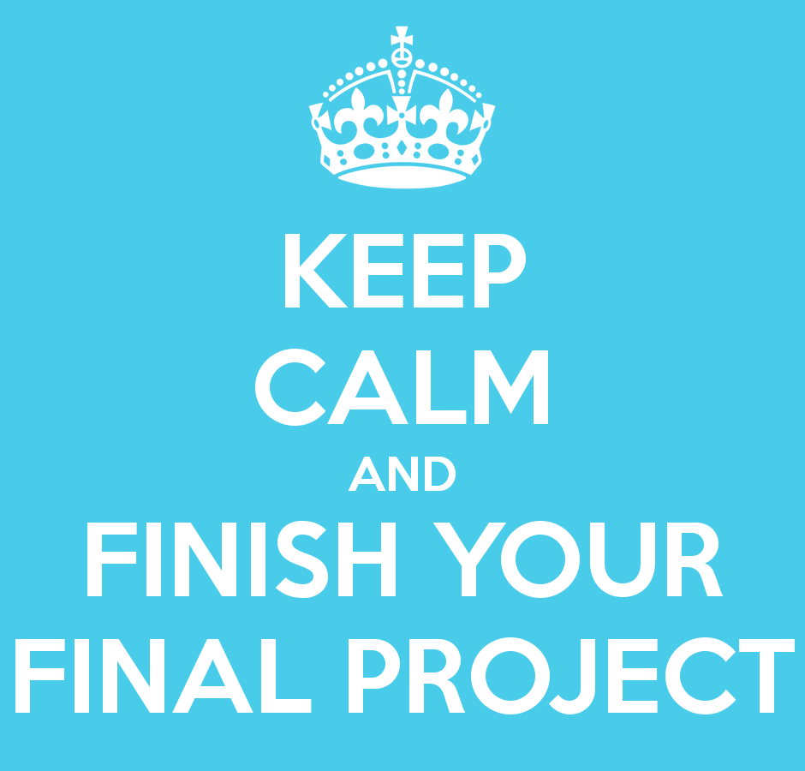
Graphics Final Project
By Kyle Kenney and Rico Adrian

Slide 2
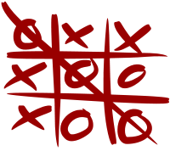
Task : Tic Tac Toe
3x3 Grid
2 Players
X or an O
Take turns marking spaces on grid.
Winner Happens:
Player has 3 marks in a horizontal, vertical, or diagonal row.

Slide 3
Added Components
Animations
Graph moves if win
Color Choices for user pieces
User has option to change color of X and O
Color strobe
Graph has different colors if win
Keyboard Interaction
Use number grid 1-9 on keyboard to determine where to put pieces.

Slide 4
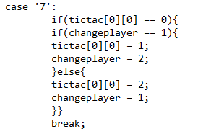
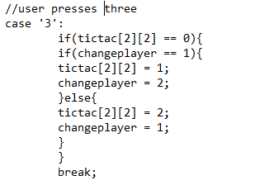
Added Components – Keyboard Presses
Key Presses
Set up a 2D array with (0,0) being the top left-hand corner and with (2.2) being the bottom right hand corner.
Used the numbers 1-9 as the grid, with number “1” as an example. Top left = ‘7’ and bottom right = ‘3’

Slide 5
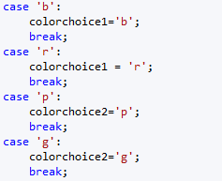
Added Components – Color Choice
Player1 can choose to be blue or red
Player 2 can choose to be purple or green

Slide 6
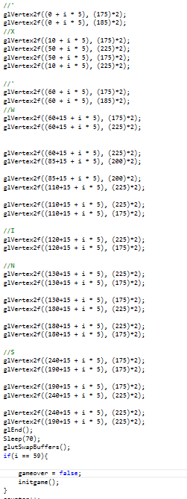
Added Components - Animation
Set up line vertexes with variable changes
Do function glutSwapBuffers() Every Time
After a certain amount of iterations, Restart game.

Slide 7
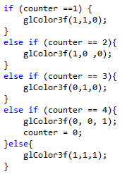
Added Components – Color Strobe
Color Strobe
Switches between four colors
Have counter and switch after each iteration

Slide 8
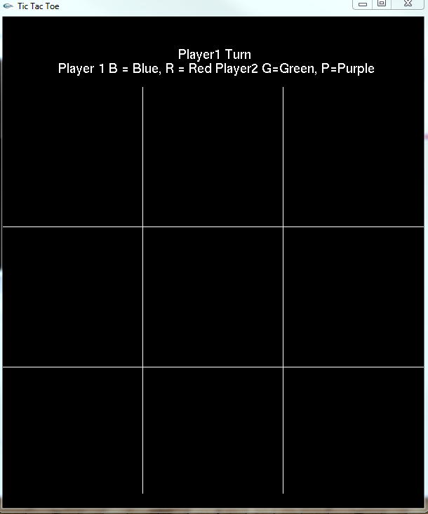
Beginning of game

Slide 9
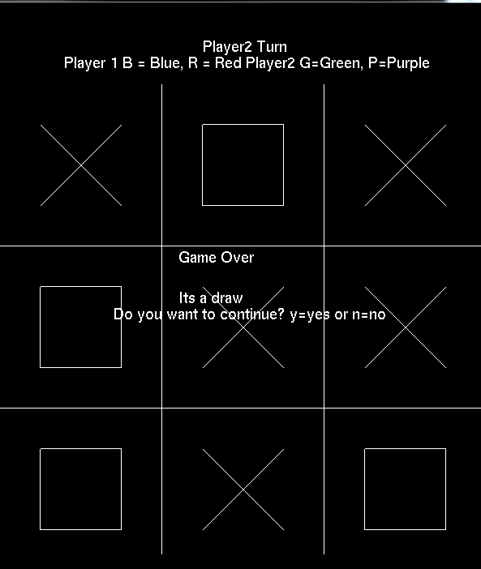
Draw

Slide 10
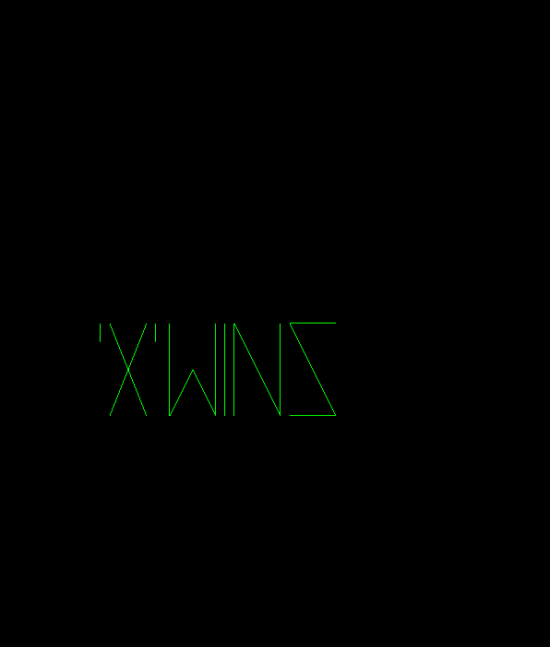
Player 1 wins

Slide 11
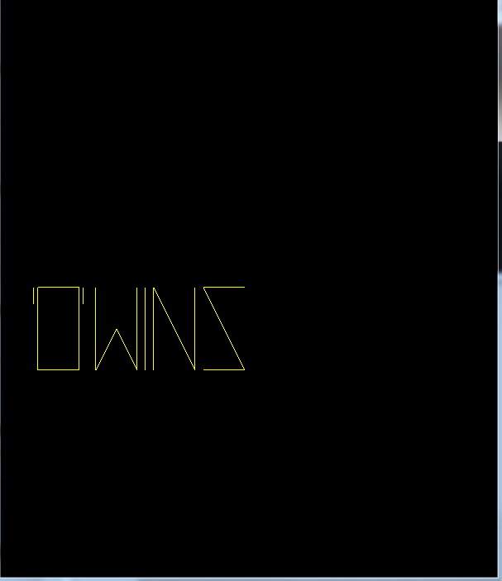
Player 2 wins

Slide 12
Run Project

